Slide 1
Billboard Generator 3.0.0
Getting Started

Slide 2
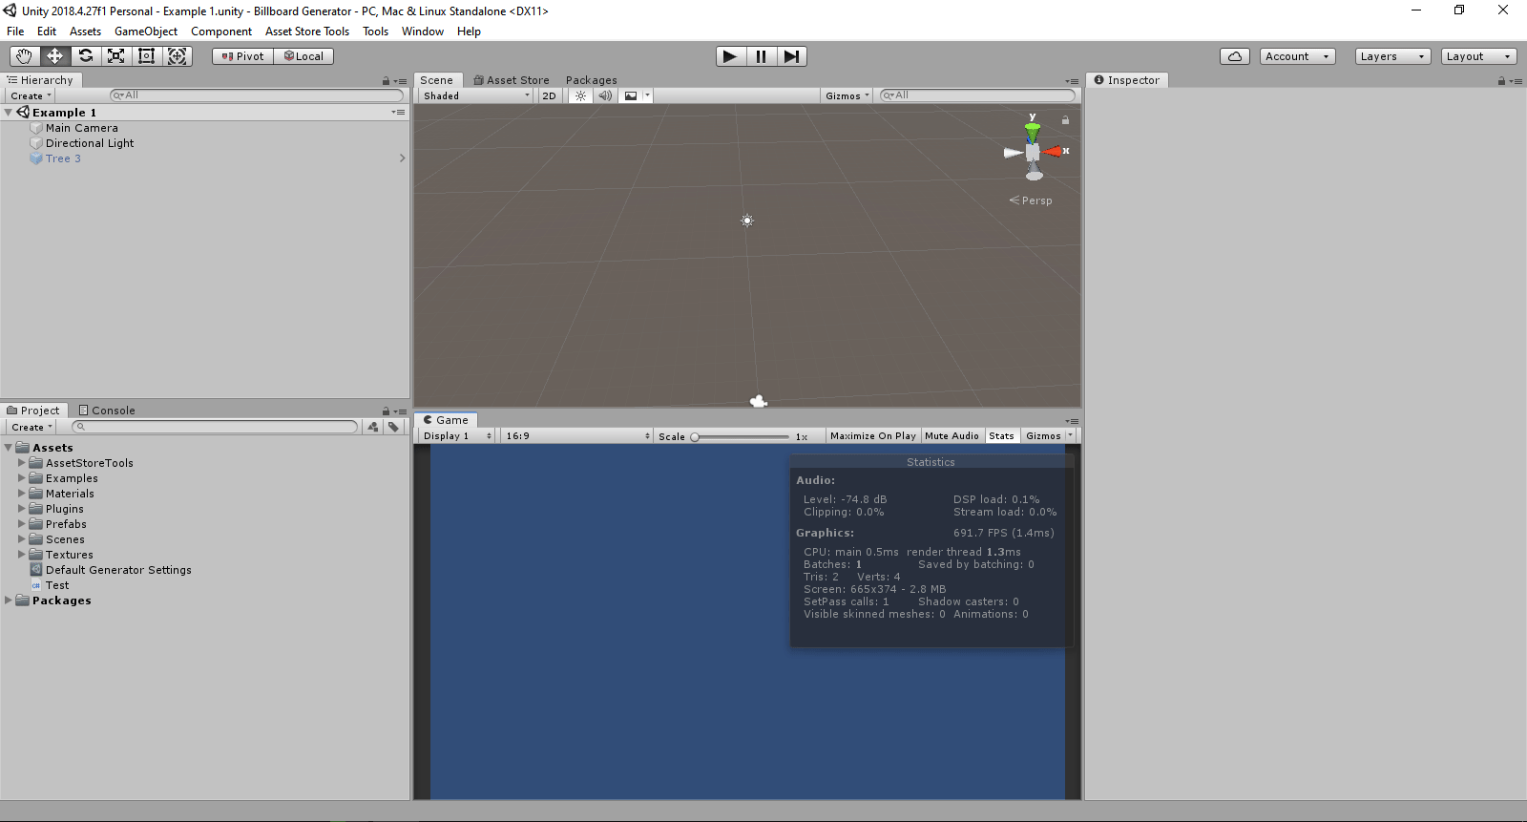
Opening Billboard Generator window

Slide 3
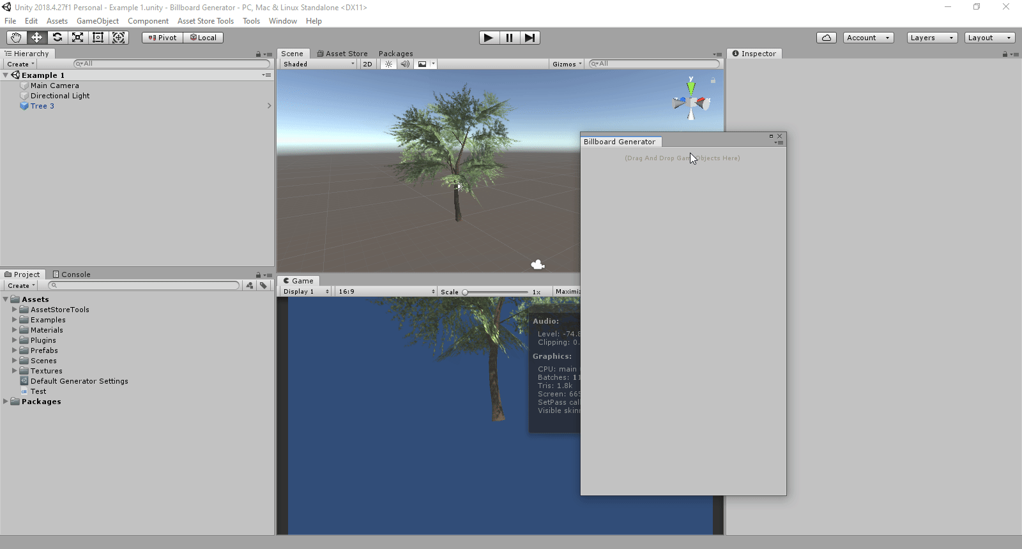
Adding GameObjects

Slide 4
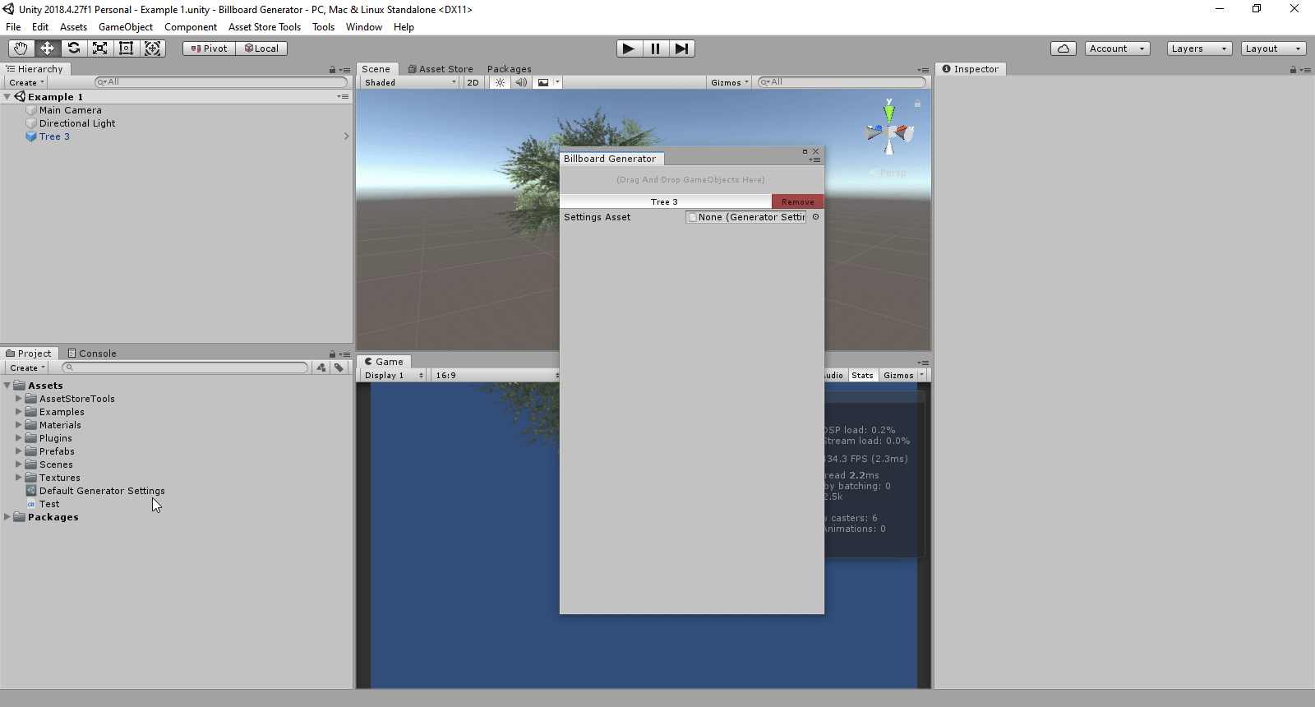
Creating a Settings Asset

Slide 5
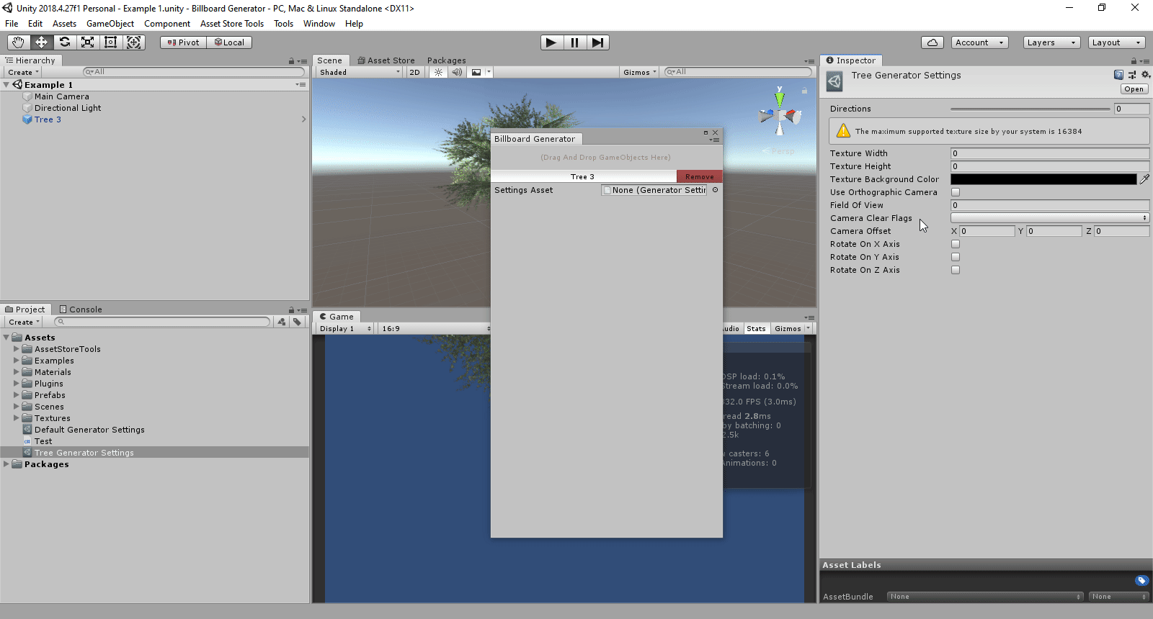
Modifying and Applying settings

Slide 6
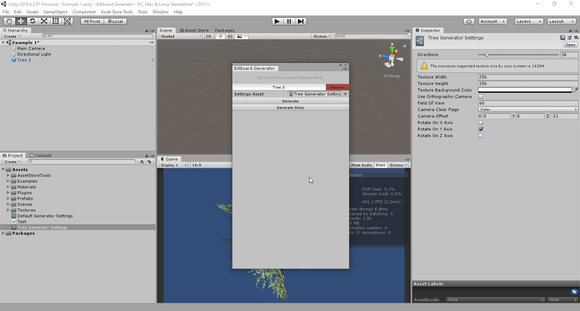
Generating a billboard atlas

Slide 7
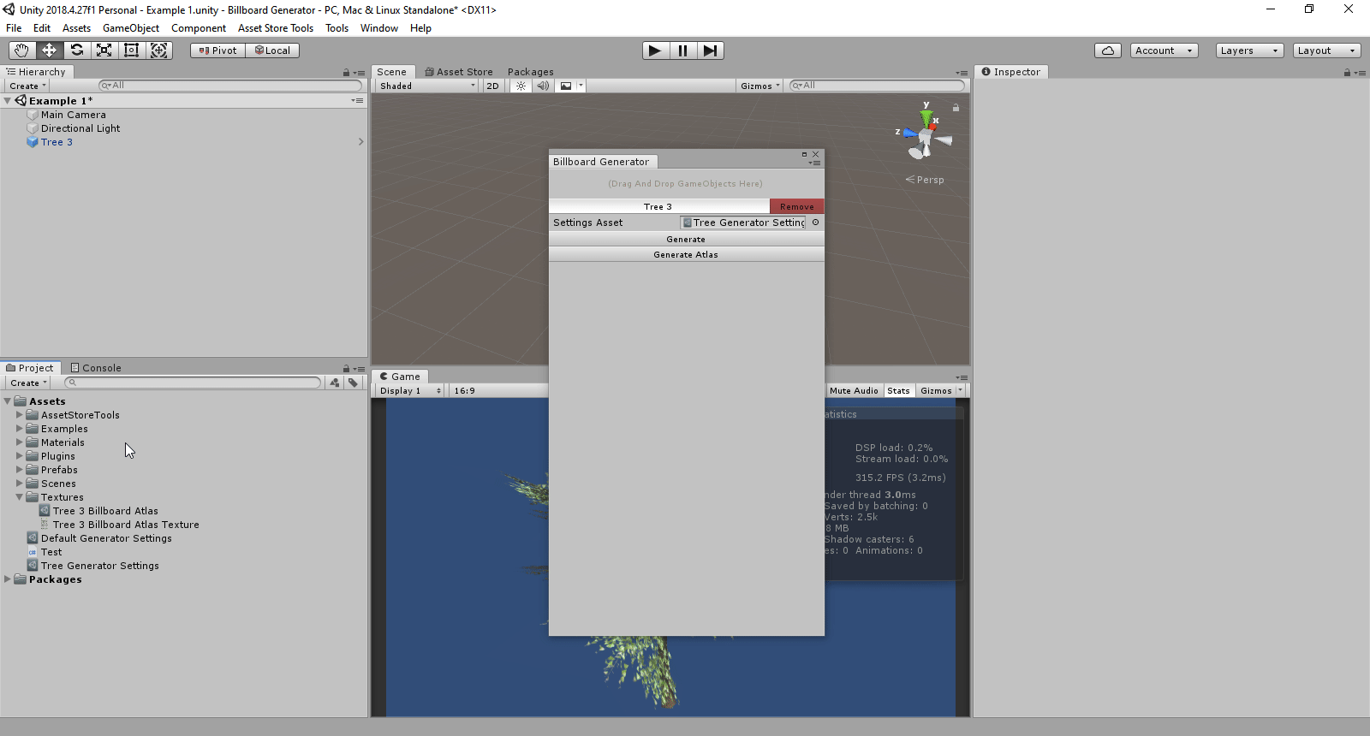
Creating a billboard material

Slide 8
Creating a billboard object

